Slide 1
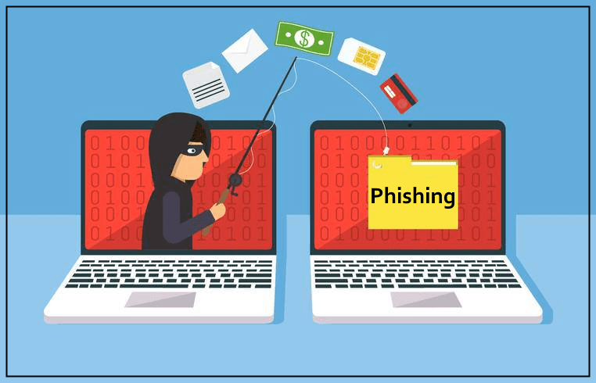
Phishing Awareness & Security Improvement Plan
Employee Security Awareness Program
Presented By: Bikash Raya

Slide 2
Purpose
Improve employee awareness of phishing threats
Reduce risk of email-based attacks
Strengthen security behavior across teams
Support safer decision-making in daily work

Slide 3
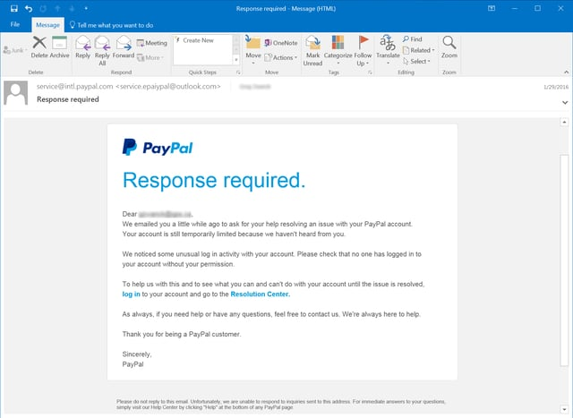
What is phishing?
Fraudulent emails/messages designed to trick users
Attempts to steal passwords or sensitive data
Often impersonates trusted companies or internal teams
Uses urgency or fear to manipulate users

Slide 4
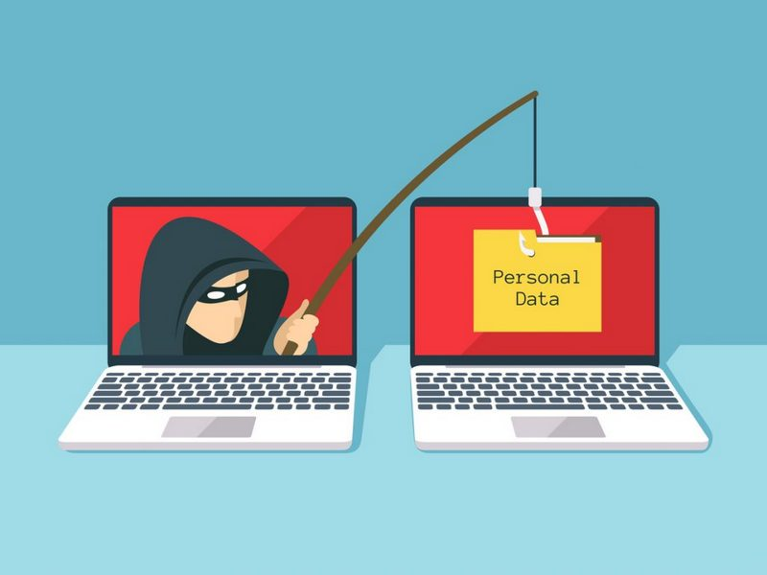
Key Risks to Teams
Credential theft and account compromise
Financial fraud or data exposure
Malware infection through attachments
Unauthorized access to internal systems

Slide 5
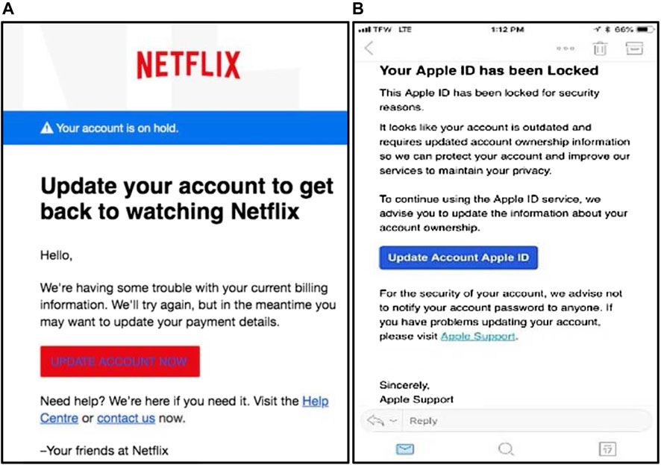
Warning Signs of Phishing
Unexpected password reset requests
Urgent or threatening language
Unknown or suspicious sender email
Links that do not match official websites
Requests for confidential information

Slide 6
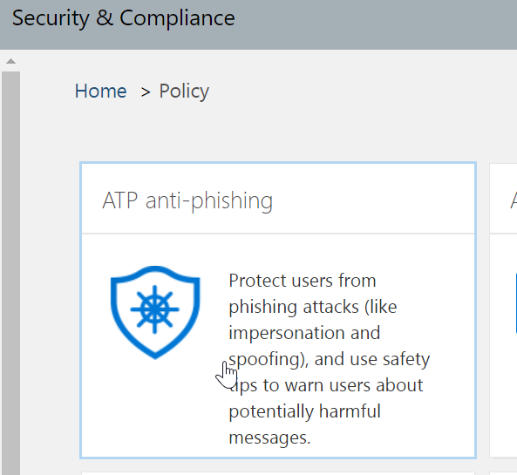
How to Stay Safe
Verify sender before responding
Do not click unknown links
Avoid downloading unexpected attachments
Use official company portals only
Report suspicious emails immediately

Slide 7
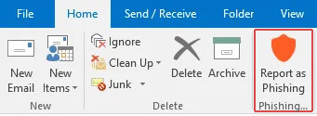
Recommended Training Actions
Regular phishing awareness sessions
Role-based training for HR & Marketing
Simulated phishing email exercises
Quick reference guides for employees
Continuous awareness reminders

Slide 8

Conclusion
Phishing is a high-risk and common threat
Awareness is the strongest defense
Early detection prevents major security incidents
Every employee plays a role in security

